Slide 1
Training data-efficient image transformers & distillation through attention
ICML 2021, arXiv:2012.12877
Hugo Touvron*,† Matthieu Cord† Matthijs Douze* Francisco Massa* Alexandre Sablayrolles* Herve Jegou*
*Facebook AI, †Sorbonne University
Reporter: Ching-Ching Yang
Date: 2021/07/15

Slide 2
Outline
Introduction and Related Work
Method
Experiments
Conclusion
Progress Report

Slide 3
Introduction
Motivated by the success of attention-based models in NLP, several researchers have proposed hybrid architecture transplanting transformer ingredients to convnets to solve vision tasks.
There also exists an architecture that directly inherited from NLP, but applied to image classification with raw image patches as input.
Vision transformer (ViT) [15]
[15] A. Dosovitskiy, L. Beyer, A. Kolesnikov, D. Weissenborn, X. Zhai, T. Unterthiner, M. Dehghani, M. Minderer, G. Heigold, S. Gelly, et al. An image is worth 16x16 words: Transformers for image recognition at scale. arXiv preprint arXiv:2010.11929, 2020.

Slide 4
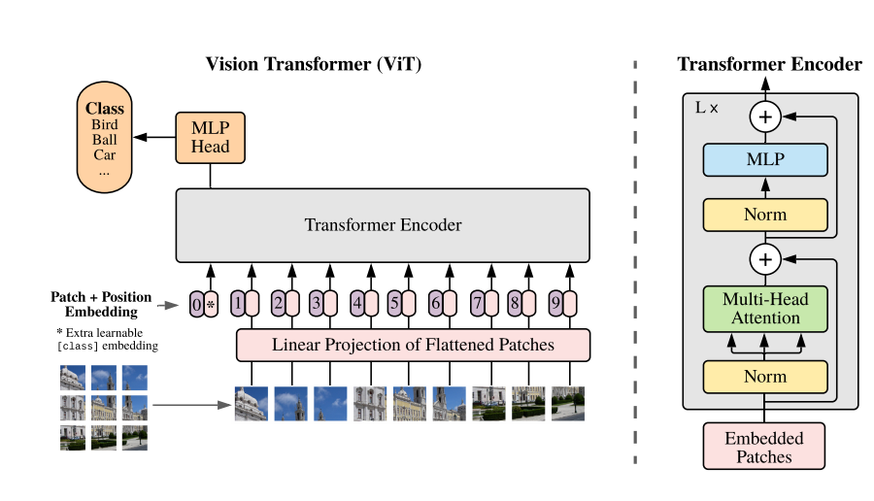
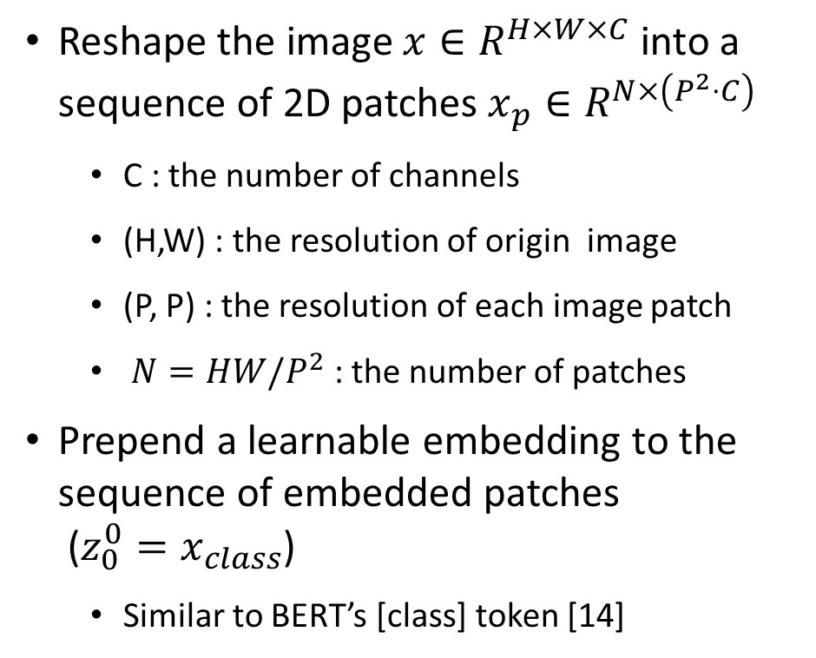
Vision Transformer (ViT)
Reshape the image $x∈R^{H×W×C}$ into a sequence of 2D patches $x_{p}∈R^{N×\left(P^{2}⋅C\right)}$
C : the number of channels
(H,W) : the resolution of origin image
(P, P) : the resolution of each image patch
$N=HW/P^{2}$ : the number of patches
Prepend a learnable embedding to the sequence of embedded patches ($z_{0}^{0}=x_{class}$)
Similar to BERT’s [class] token [14]
[14] Jacob Devlin, Ming-Wei Chang, Kenton Lee, and Kristina Toutanova. BERT: Pre-training of deep bidirectional transformers for language understanding. In NAACL, 2019.

Slide 5
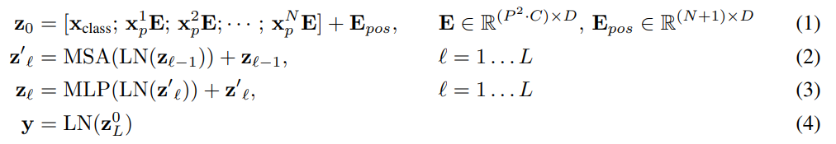
Vision Transformer (ViT)
Formula:
ViT presented excellent results with transformers trained with a large private labelled image dataset
Transformers “do not generalize well when trained on insufficient amounts of data”
→ Cons: the training of these models involved extensive computing resources.
* E: the patch embedding projection ; D: dimension, constant latent vector size ; L : number of encoder block

Slide 6
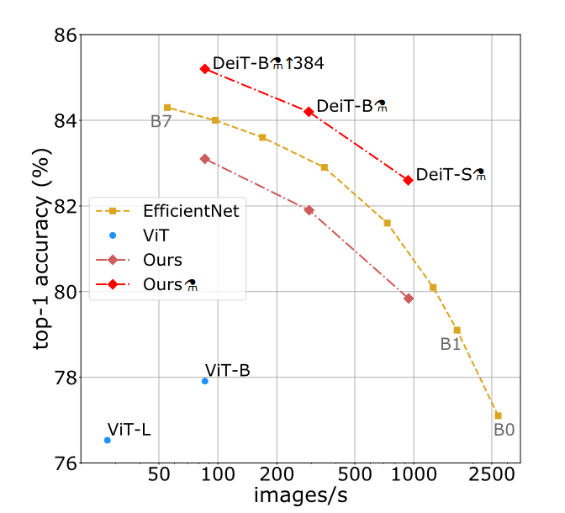
Contributions
Data-efficient image Transformers (DeiT) (proposed)
Based on ViT, but with better training strategies
With a new distillation procedure
Distillation token : it plays the same role as the class token, except that it aims at reproducing the label estimated by the teacher.

Slide 7
Outline
Introduction and Related Work
Method: Distillation through attention
Soft distillation
Hard distillation
Distillation token
Experiments
Conclusion
Progress Report

Slide 8
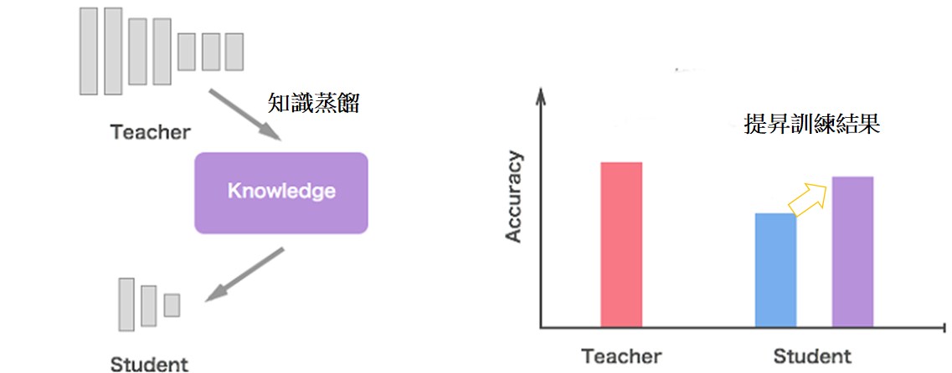
Knowledge Distillation

Slide 9
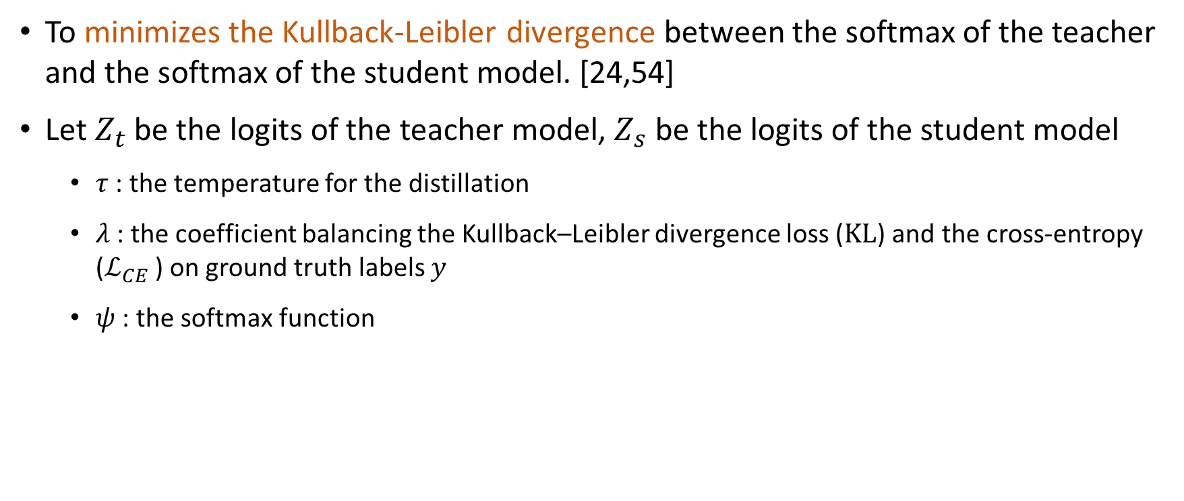
Soft distillation
To minimizes the Kullback-Leibler divergence between the softmax of the teacher and the softmax of the student model. [24,54]
Let $Z_{t}$ be the logits of the teacher model, $Z_{s}$ be the logits of the student model
$τ$ : the temperature for the distillation
$λ$ : the coefficient balancing the Kullback–Leibler divergence loss ($KL$) and the cross-entropy ($ℒ_{CE}$ ) on ground truth labels $y$
$ψ$ : the softmax function
[24] Geoffrey E. Hinton, Oriol Vinyals, and J. Dean. Distilling the knowledge in a neural network. arXiv preprint arXiv:1503.02531, 2015.
[54] L. Wei, A. Xiao, L. Xie, X. Chen, X. Zhang, and Q. Tian. Circumventing outliers of auto augment with knowledge distillation. European Conference on Computer Vision, 2020.

Slide 10

Hard-label distillation
In this distillation method, we take the hard decision of the teacher as a true label.
Let $y_{t}=argmax_{c} Z_{t}(c)$ be the hard decision of the teacher,

Slide 11
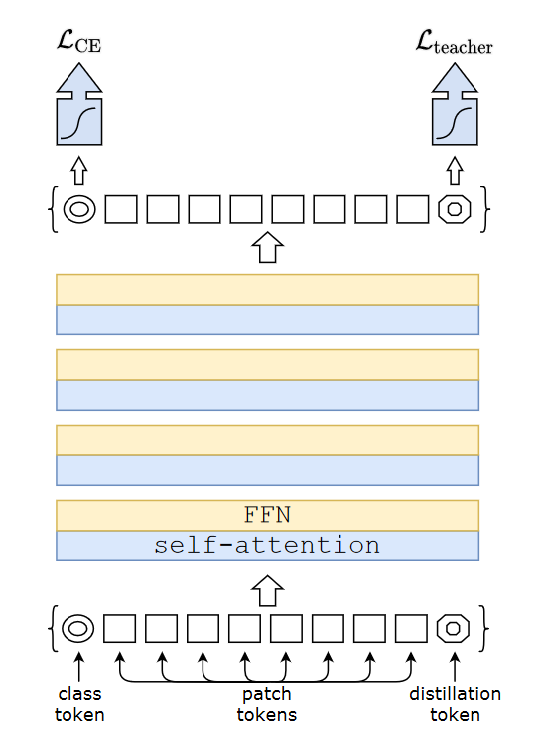
Distillation token
The distillation token interacts with the class and patch tokens through the self-attention layers.
It is employed in a similar fashion as the class token, except that on output of the network its objective is to reproduce the (hard) label predicted by the teacher, instead of true label.

Slide 12
(Cont.)
We observe that the learned class and distillation tokens converge towards different vectors:
the average cosine similarity between these tokens equal to 0.06
As the class and distillation embeddings are computed at each layer, they gradually become more similar through the network, all the way through the last layer at which their similarity is high (cos=0.93)
This is expected since as they aim at producing targets that are similar but not identical.

Slide 13
Outline
Introduction and Related Work
Method
Experiments
Conclusion
Progress Report

Slide 14
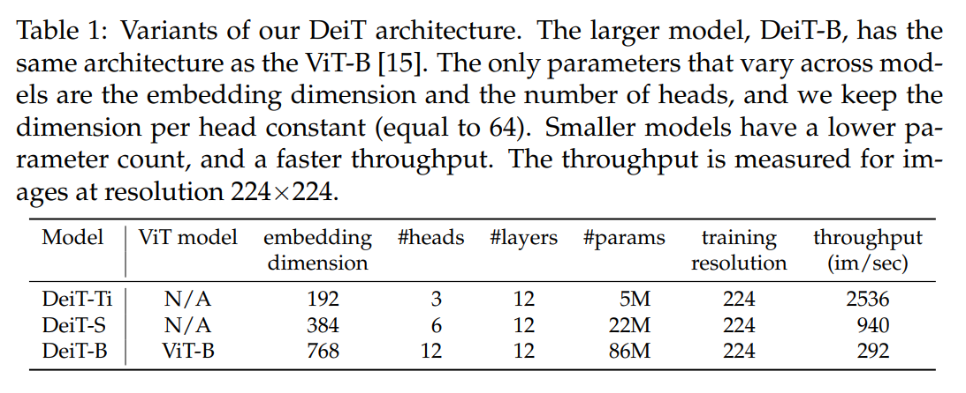
Transformer models
[15] A. Dosovitskiy, L. Beyer, A. Kolesnikov, D. Weissenborn, X. Zhai, T. Unterthiner, M. Dehghani, M. Minderer, G. Heigold, S. Gelly, et al. An image is worth 16x16 words: Transformers for image recognition at scale. arXiv preprint arXiv:2010.11929, 2020.

Slide 15
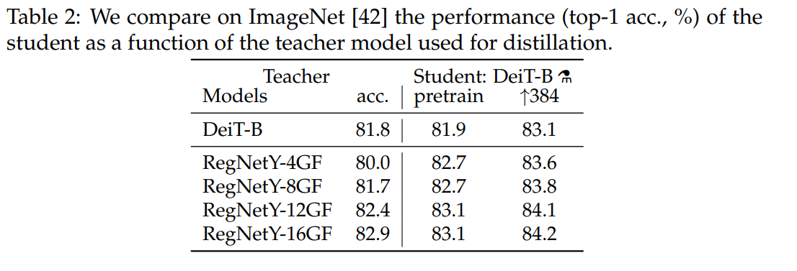
Distillation - Convnets teachers
The convnet [40] is a better teacher is probably due to the inductive bias inherited by the transformers through distillation.
*Pretrain on 224*224 images;
Finetune on 384*384 images
Default teacher
[40] I. Radosavovic, R. Prateek Kosaraju, R.B. Girshick, K. He, and P. Dollar. Designing network design spaces. Conference on Computer Vision and Pattern Recognition, 2020.
[42] O. Russakovsky, J. Deng, H. Su, J. Krause, S. Satheesh, S. Ma, Z. Huang, A. Karpathy, A. Khosla, M. Bernstein, A.C. Berg, and Li Fei-Fei. Imagenet large scale visual recognition challenge. International journal of Computer Vision, 2015.

Slide 16
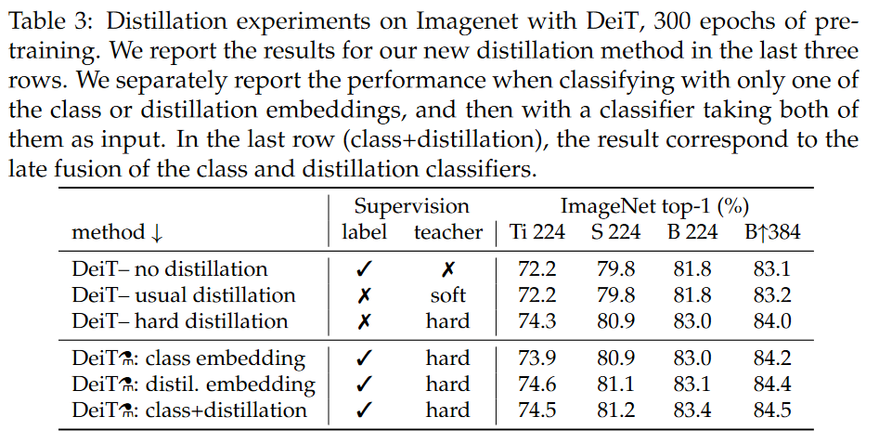
Distillation - Comparison of distillation methods

Slide 17
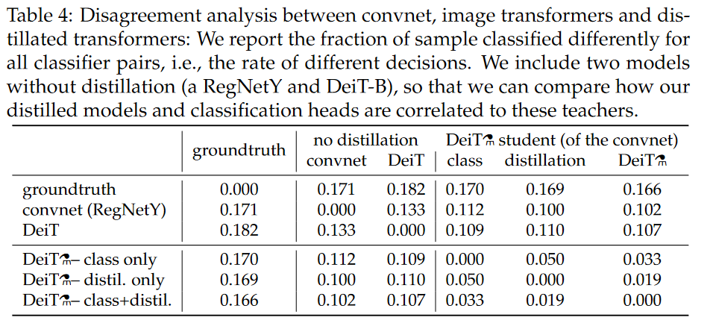
Agreement with the teacher & inductive bias?
* 一致性 (對角)

Slide 18
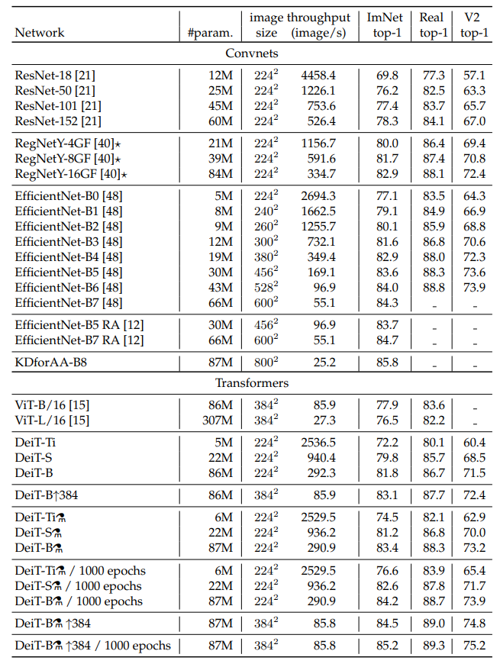
Efficiency vs Accuracy
Throughput : the number of images that we can process per second on one 16GBV100 GPU
Accuracy on Imagenet, Imagenet Real and Imagenet V2 matched frequency of DeiT and of several state-of-the-art convnets, for models trained with no external data.

Slide 19
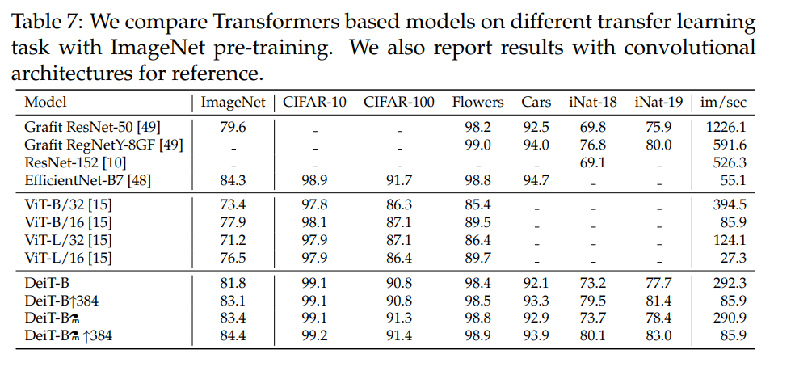
Transfer learning: Performance on downstream tasks

Slide 20
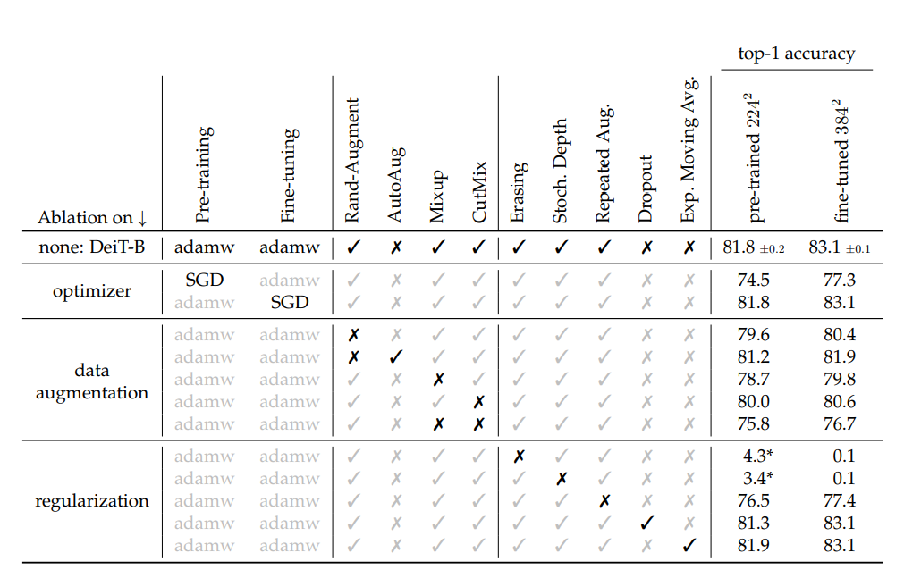
Ablation Study

Slide 21
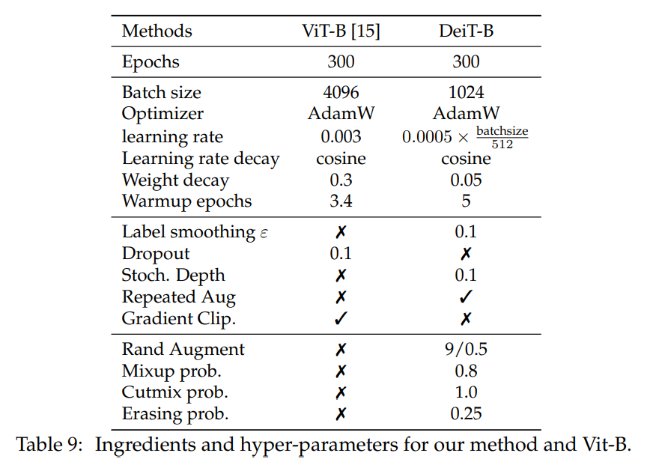
Hyper-parameters Setting

Slide 22
Outline
Introduction and Related Work
Method
Experiments
Conclusion
Progress Report

Slide 23
Conclusion
In this paper, we have introduced DeiT, which are image transformers that do not require very large amount of data to be trained, thanks to improved training and in particular a novel distillation procedure.

Slide 24
THANKS
for your listening

